Slide 1
Web Development

Slide 2
Requirements
Download & Install Docker Desktop
Download & Install Visual Studio Code
Create Github.com account

Slide 3
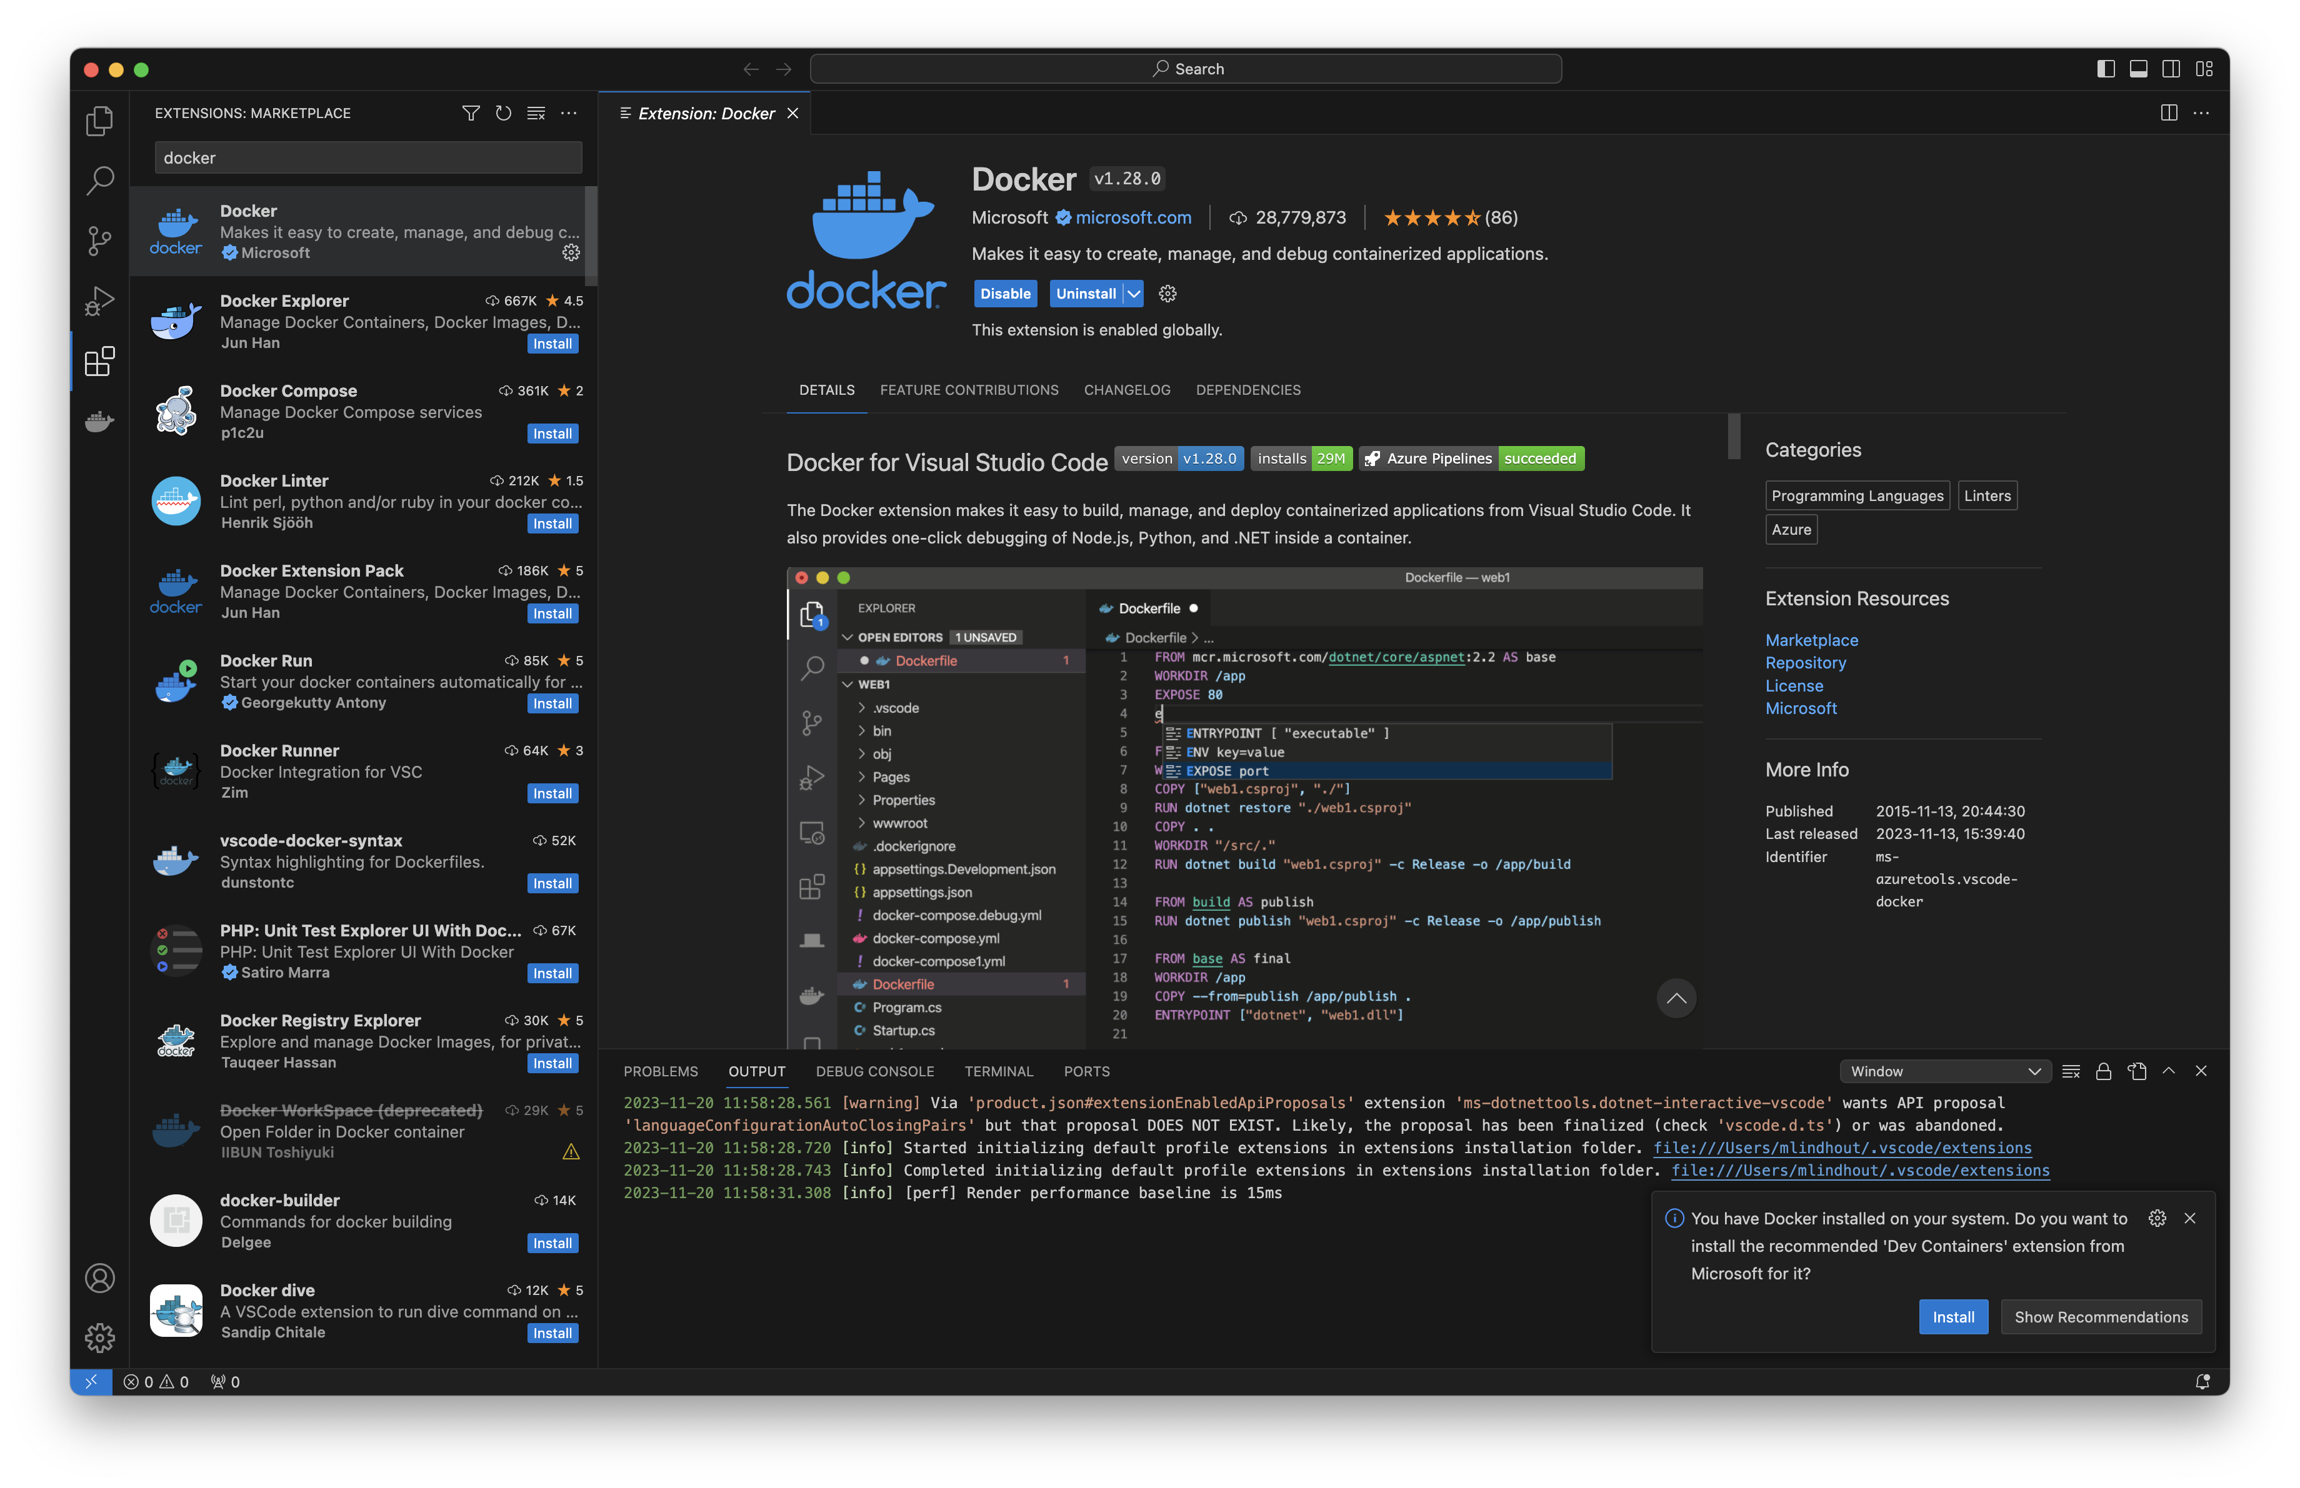
Docker plugin
On the toolbar, click on ‘Extensions’
Search for ‘Docker’ and click ‘install’

Slide 4
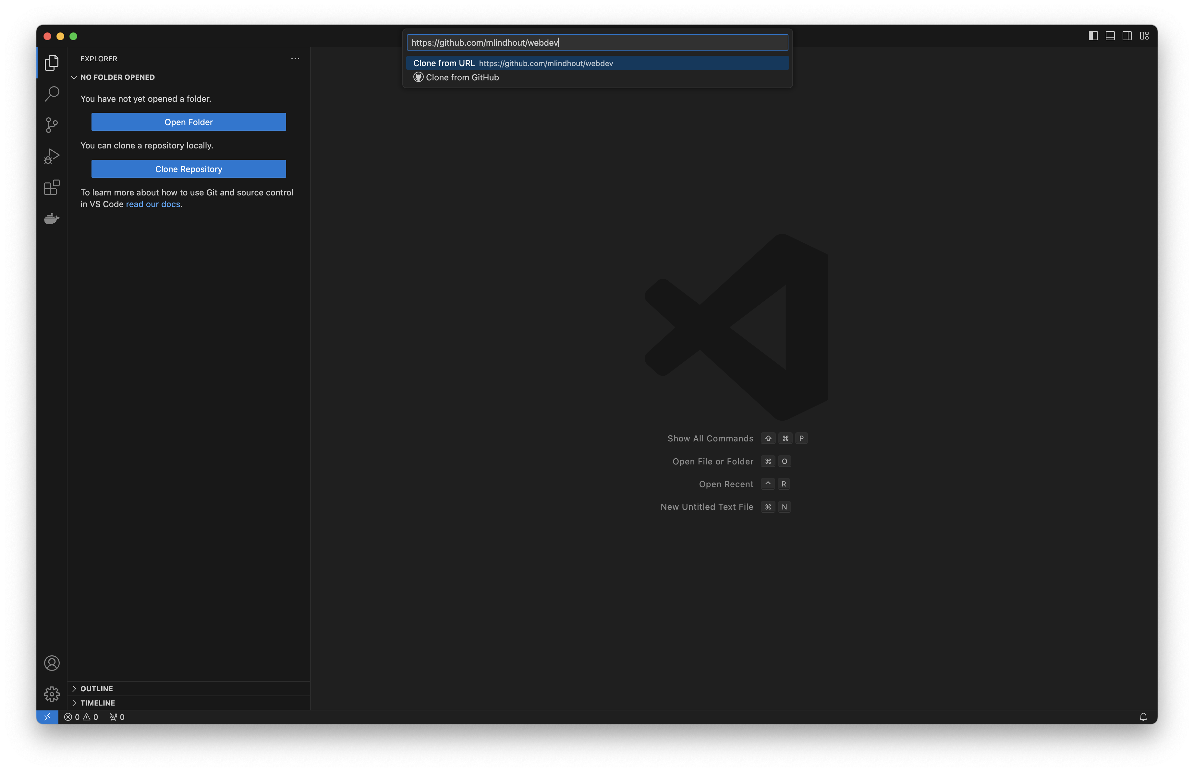
Clone repository
On the toolbar, click on ‘Explorer’, then, ‘Clone Repository’
Enter ‘https://github.com/mlindhout/webdev’
Click on ‘Open’ when asked to open window

Slide 5
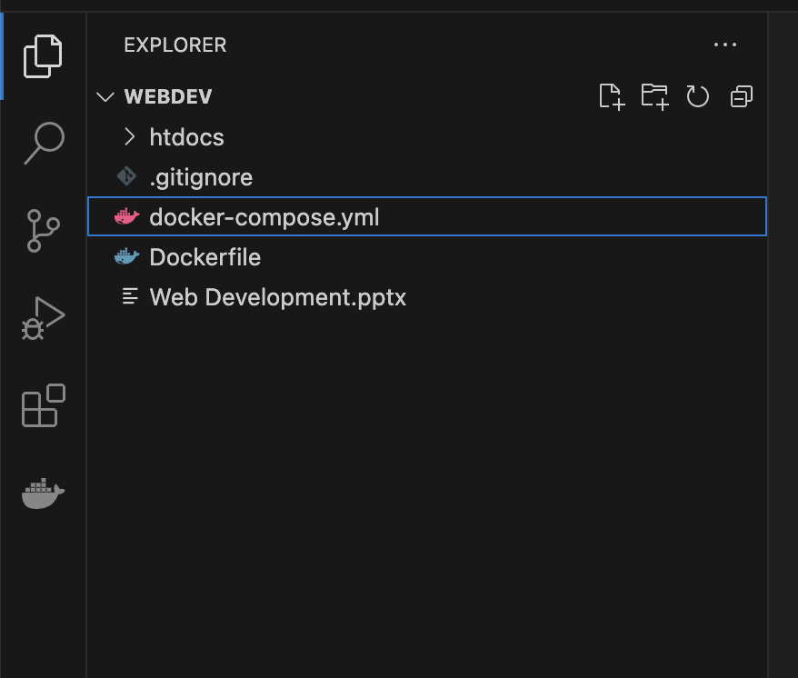
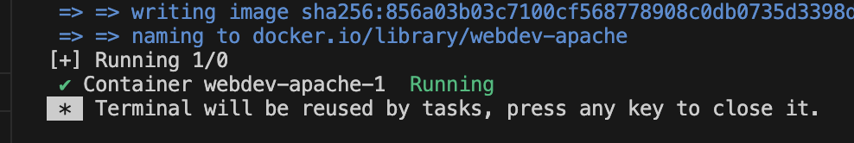
In the Explorer, left-click on docker-compose.yml and choose ‘Compose Up’
Notice what happens and wait for the green ‘Running’ message
Open http://localhost in your browser
You should see a message ‘Hello, world!’

Slide 6
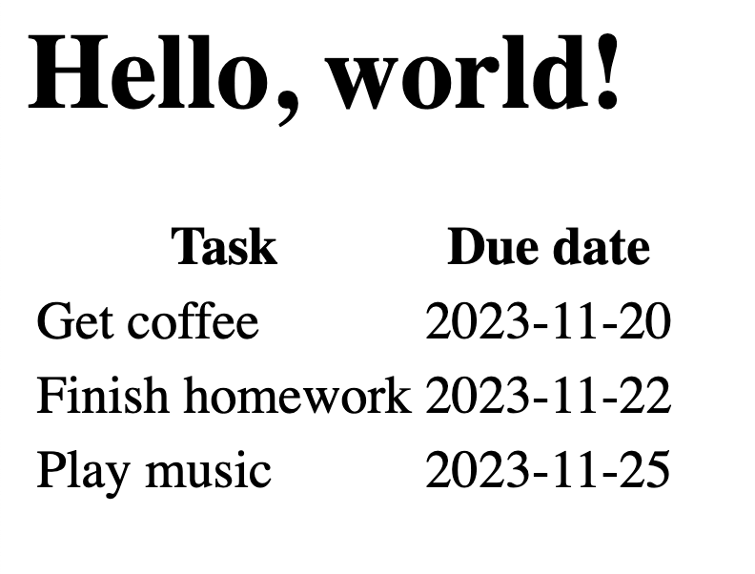
Exercise 001
Modify the file index.html:
- add a table with two columns and 3 rows
- make the column headings bold
Learning resources
https://www.w3schools.com/html/html_intro.asp
https://www.w3schools.com/html/html_basic.asp
https://www.w3schools.com/html/html_elements.asp
https://www.w3schools.com/html/html_attributes.asp
https://www.w3schools.com/html/html_tables.asp

